Slide 1
Kubernetes Dashboard

Slide 2
Deploy and Access the Kubernetes Dashboard
Dashboard is a web-based Kubernetes user interface. You can use Dashboard to deploy containerized applications to a Kubernetes cluster, troubleshoot your containerized application, and manage the cluster resources. You can use Dashboard to get an overview of applications running on your cluster, as well as for creating or modifying individual Kubernetes resources (such as Deployments, Jobs, DaemonSets, etc). For example, you can scale a Deployment, initiate a rolling update, restart a pod or deploy new applications using a deploy wizard.

Slide 8
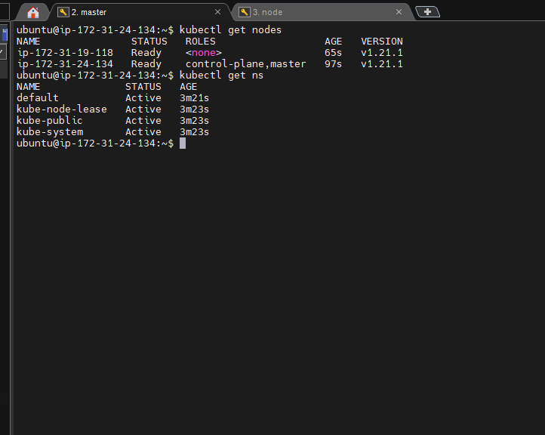

Slide 9
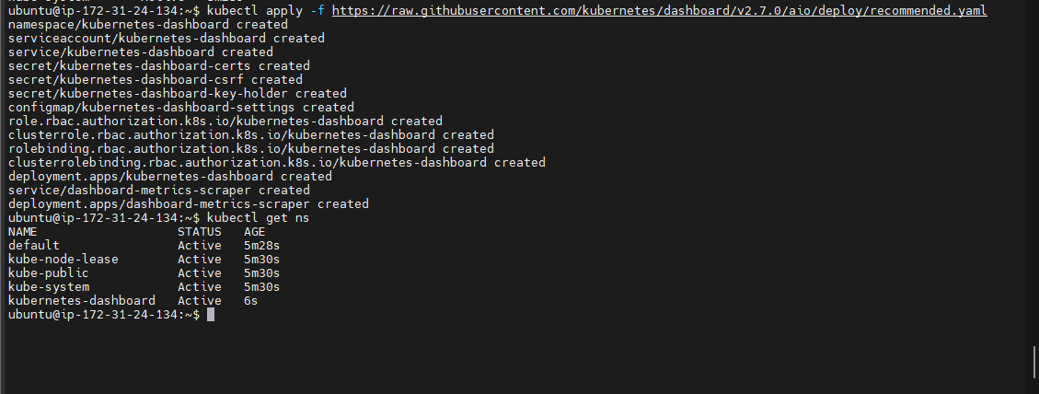
kubectl apply -f https://raw.githubusercontent.com/kubernetes/dashboard/v2.7.0/aio/deploy/recommended.yaml

Slide 10
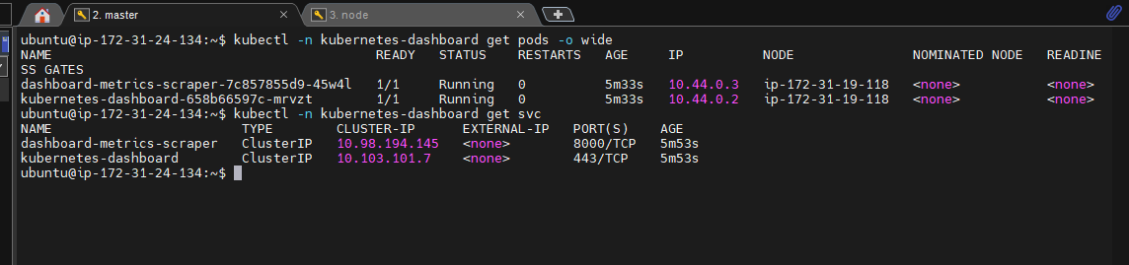

Slide 11
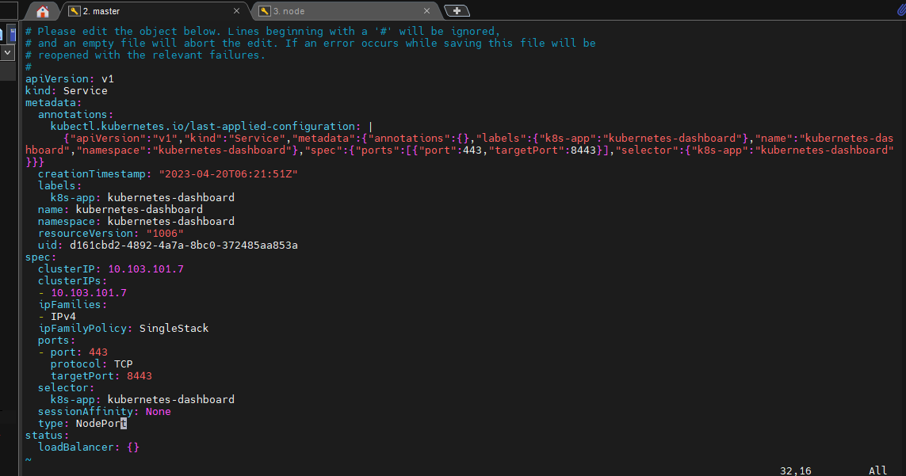

Slide 12
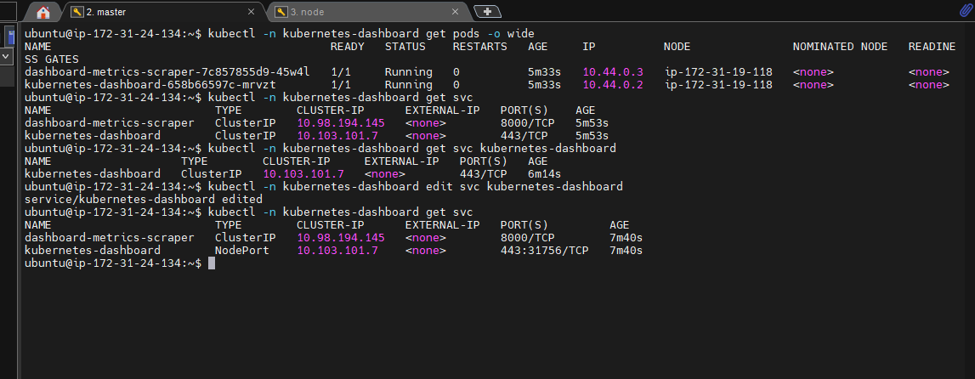

Slide 13
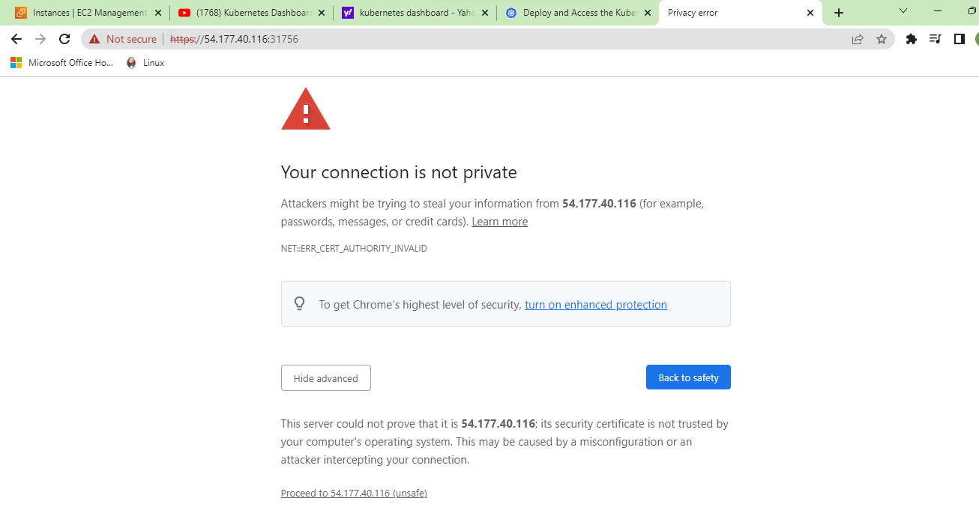

Slide 14
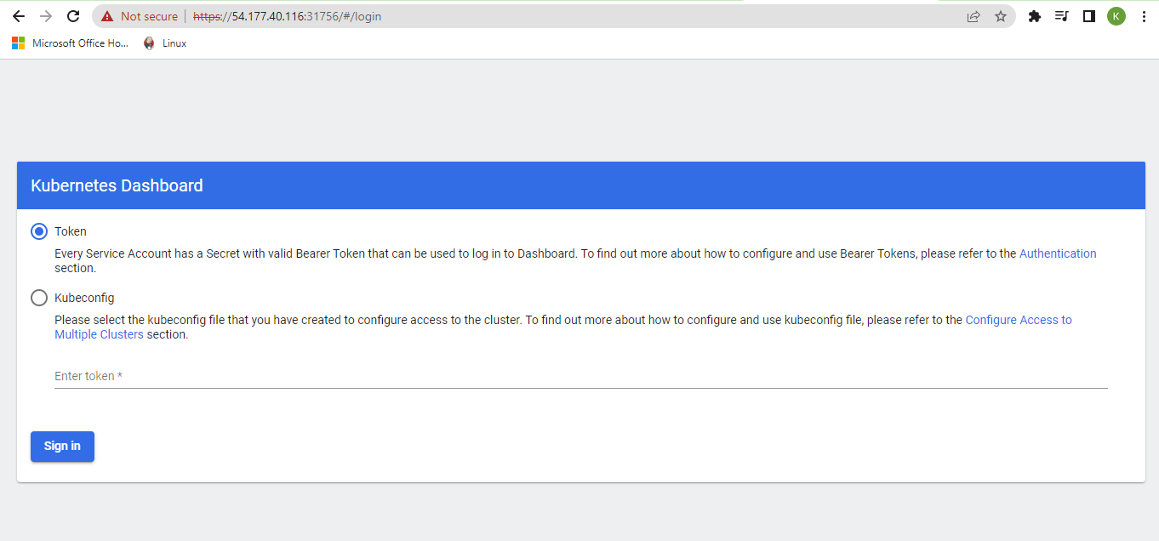

Slide 15
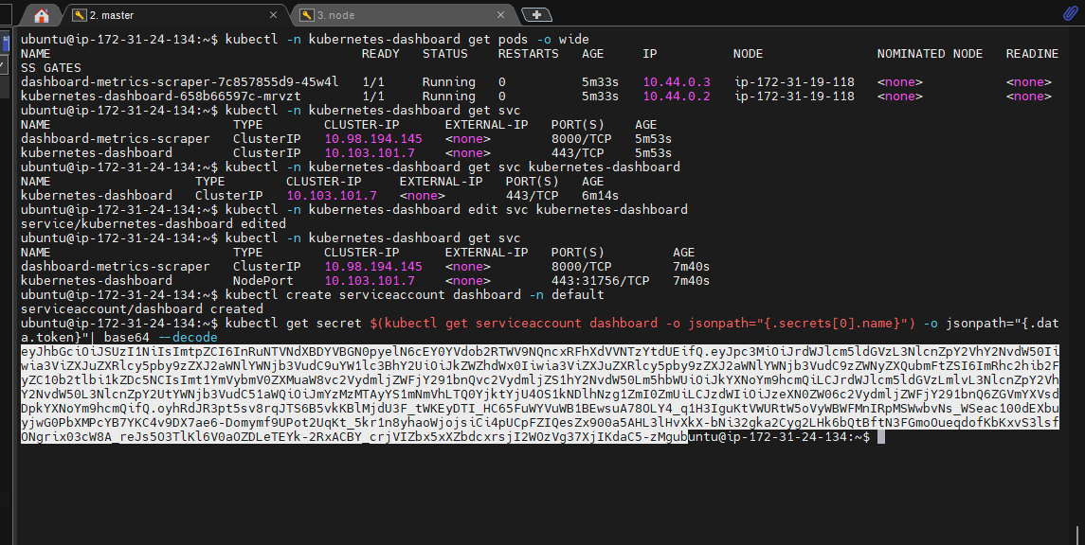

Slide 16
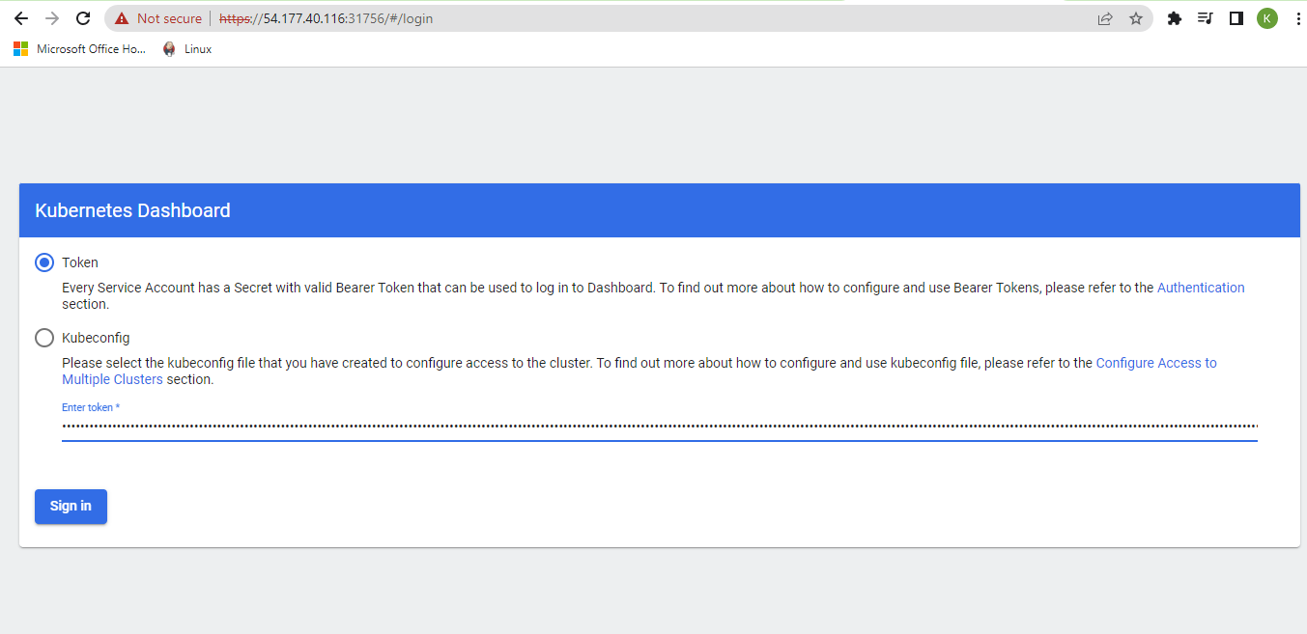

Slide 17
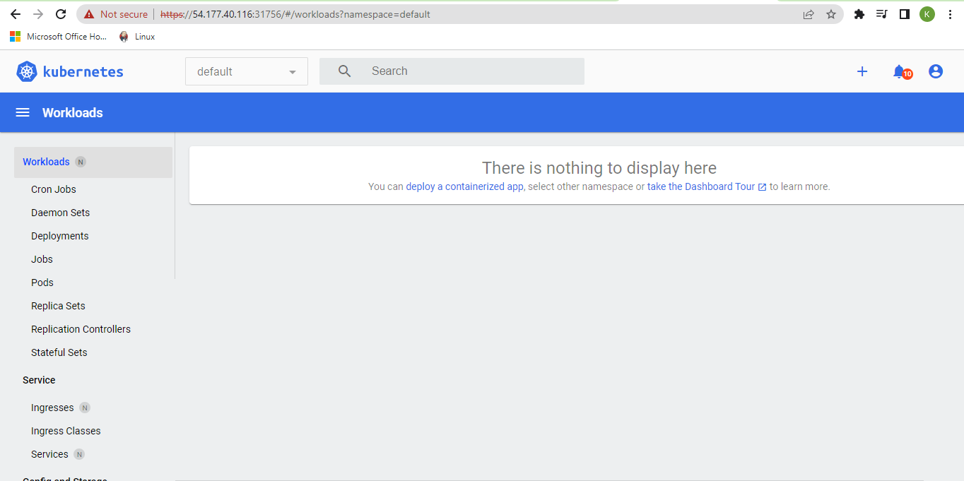

Slide 18
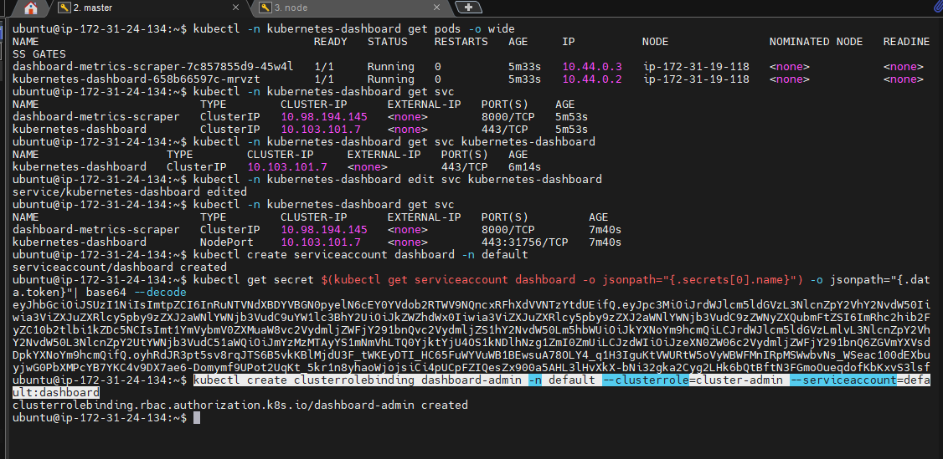

Slide 19
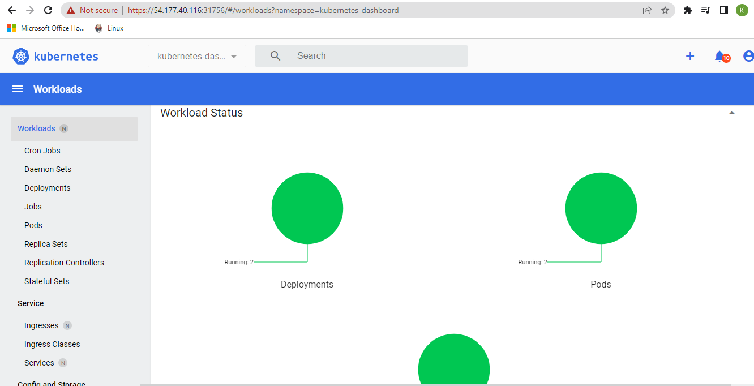

Slide 20
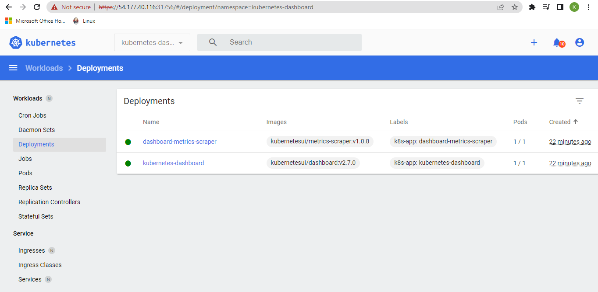

Slide 21
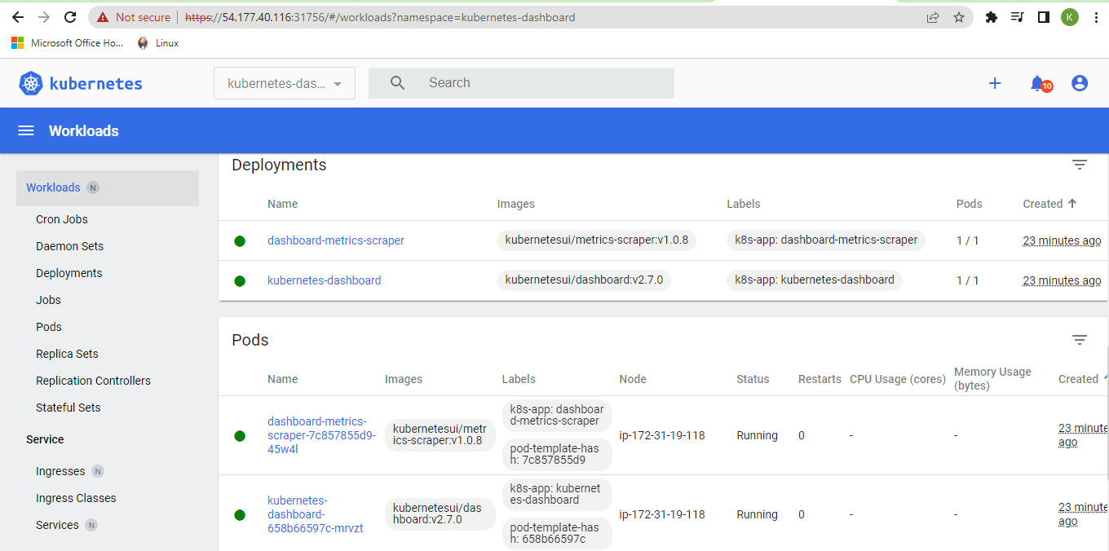

Slide 22
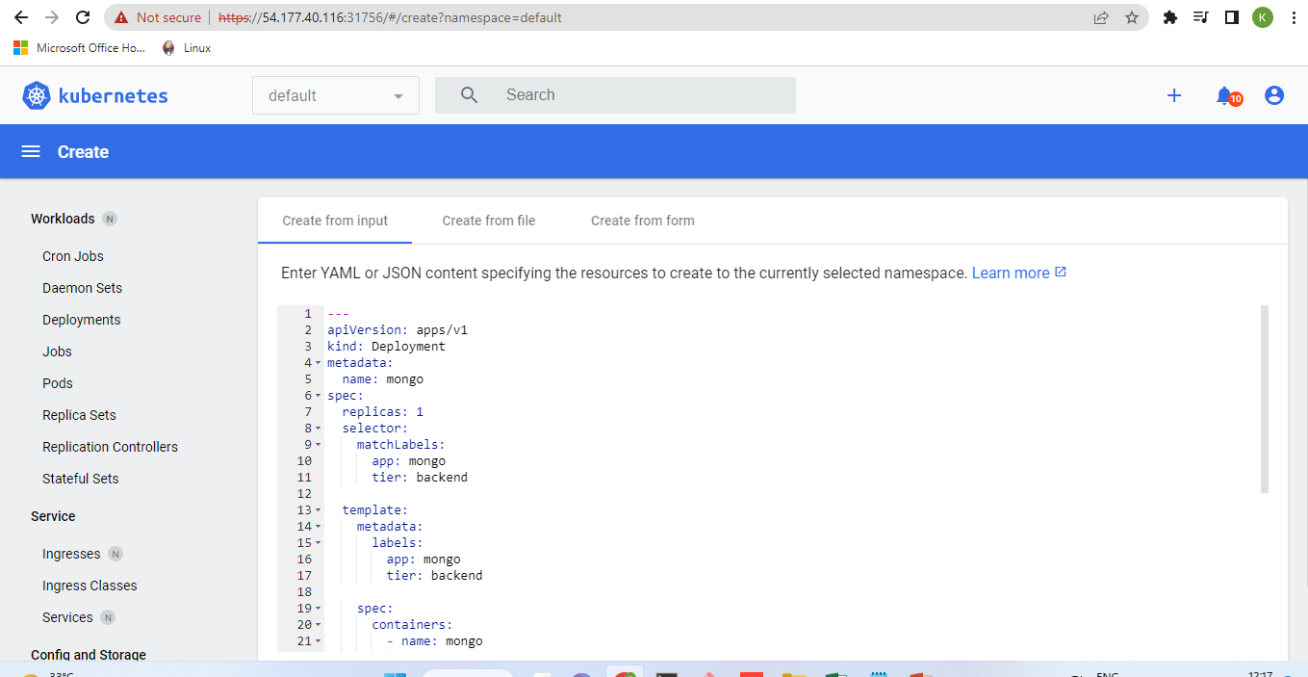

Slide 23
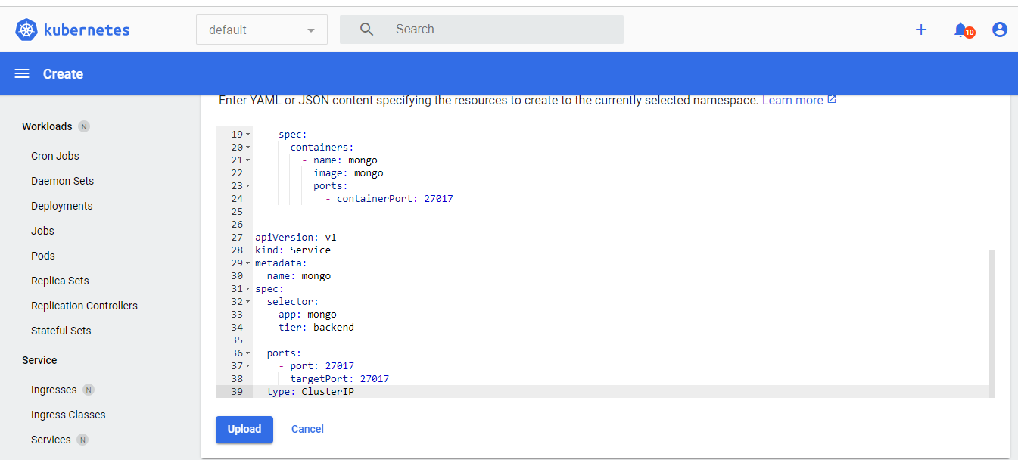

Slide 24
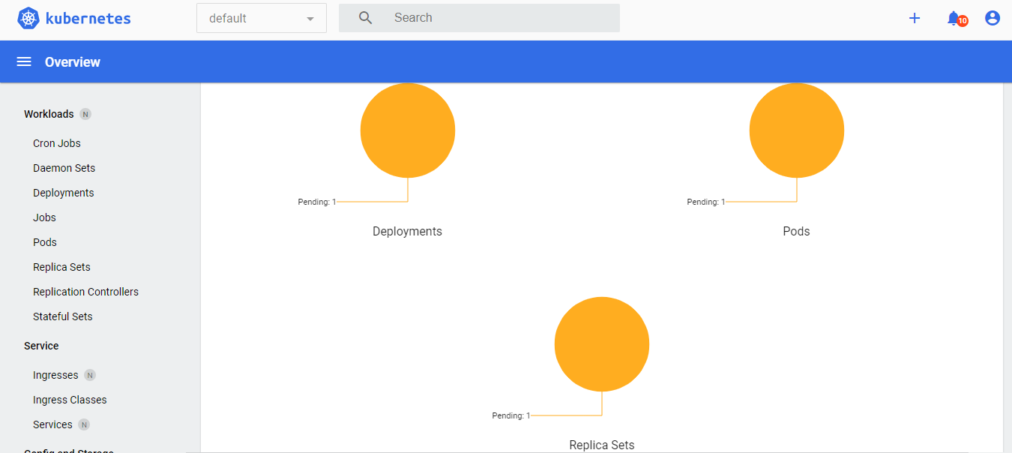

Slide 25
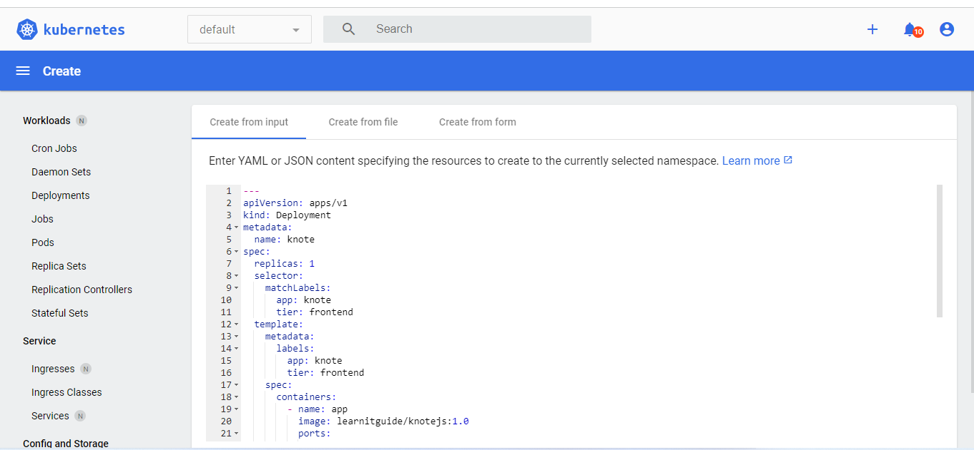

Slide 26
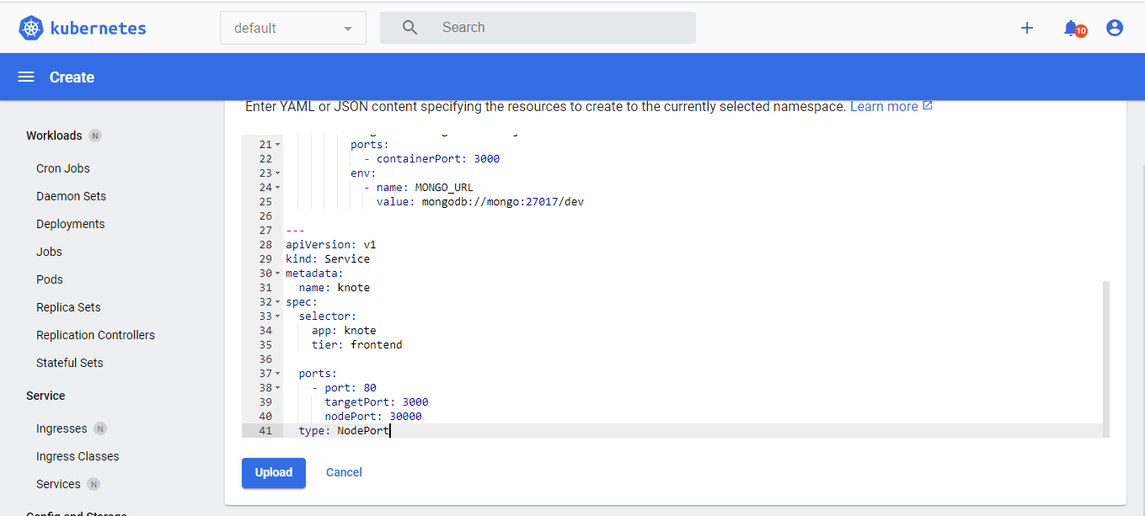

Slide 27
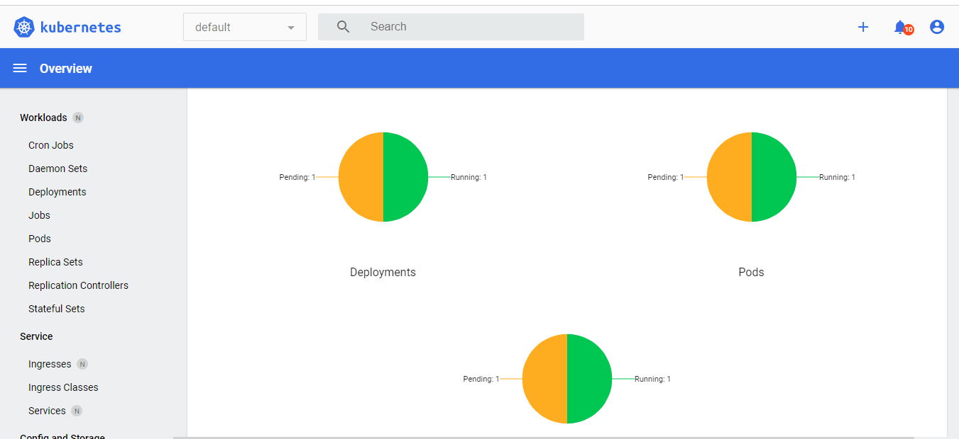

Slide 28
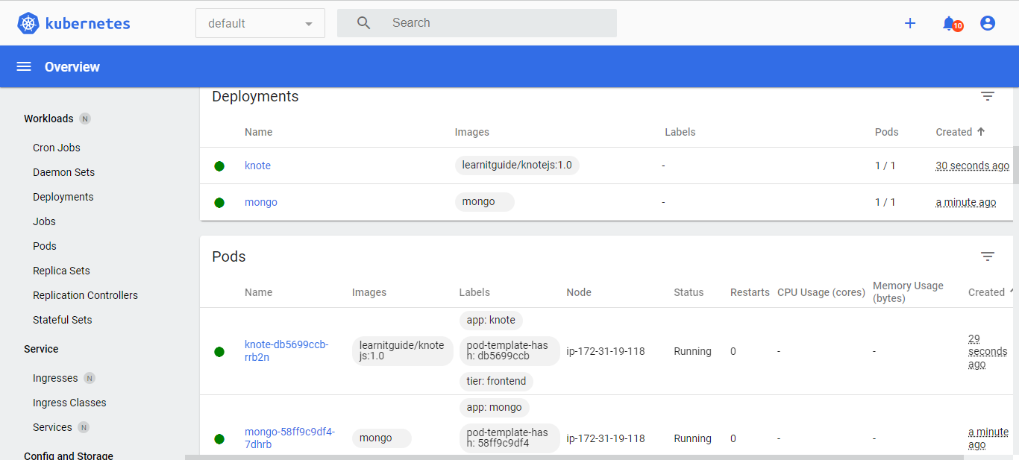

Slide 29
